Slide 1
STUDENT DATABASE MANAGEMENT SYSTEM
Submitted by - Aditya Saroj(co21304) Submitted to - Dr. Sarabjit Singh
Gurpartap Singh (co21319)

Slide 2
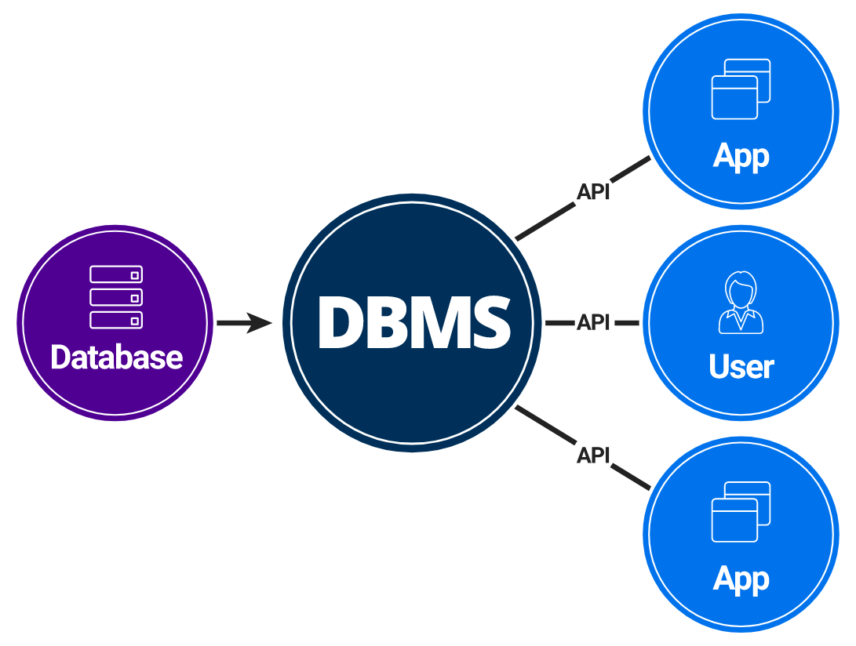
DATABASE MANAGEMENT SYSTEM
A database management system (DBMS) is system software for creating and managing databases. A DBMS makes it possible for end users to create, protect, read, update and delete data in a database .

Slide 3
WHAT IS THE NEED OF A DATABASE MANAGEMENT SYSTEM
An organized and systematic office solution is essential for all universities and organizations. There are many departments of administration for the maintenance of college information and student databases in any institution. All these departments provide various records regarding students. Most of these track records need to maintain information about the students. This information could be the general details like student name, address, performance, attendance etc or specific information related to departments like collection of data.
All the modules in college administration are interdependent. They are maintained manually. So they need to be automated and centralized as, Information from one module will be needed by other modules. For example when a student needs his course completion certificate it needs to check many details about the student like his name, reg number, year of study, exams he attended and many other details. So it needs to contact all the modules that are office, department and examination and result of students.

Slide 4
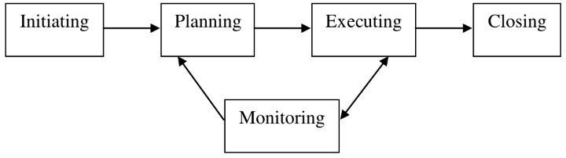
PROJECT REVIEW

Slide 5
PROJECT DESCRIPTION
1 - A minimalist desktop app to managae students record. record are saved directly on an excel file to decrease data Entry labour cost and improves efficiency.
2 - Launch the srm.exe file directly to use the App.
3 - For testing purpose both passwords are set to "password".
4- Admin have full access to manipulate the data.
5- Student account can only view the data.

Slide 6
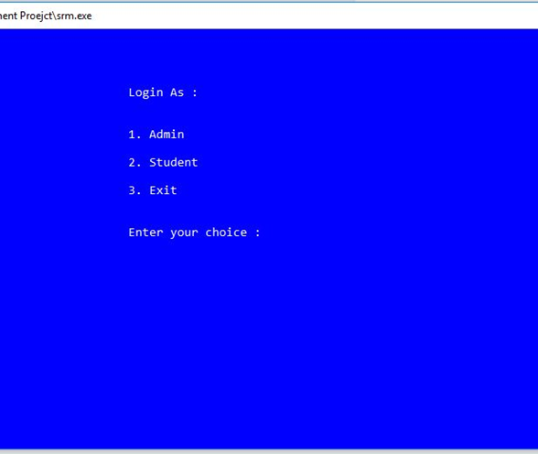
LOGIN

Slide 7
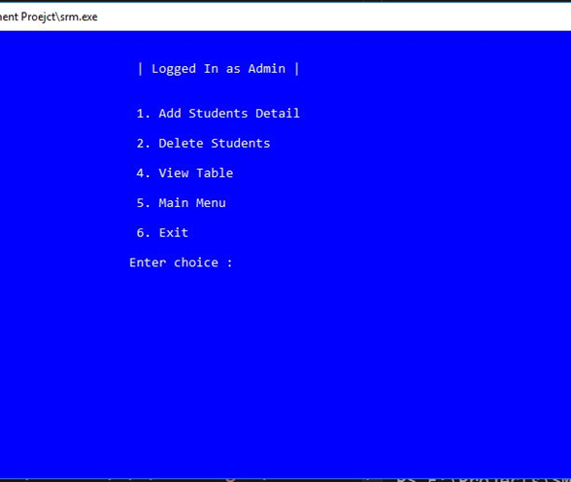
LOGGED IN AS ADMIN

Slide 8
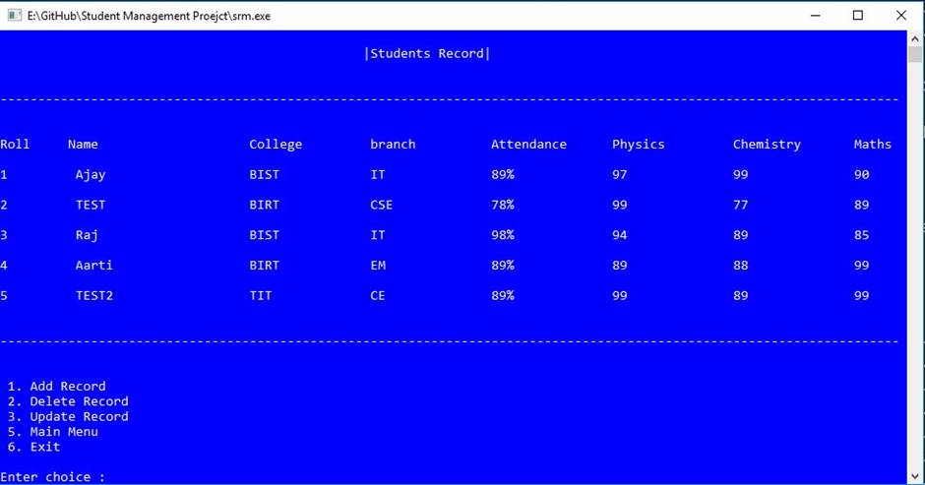
VIEWING STUDENT RECORDS

Slide 9
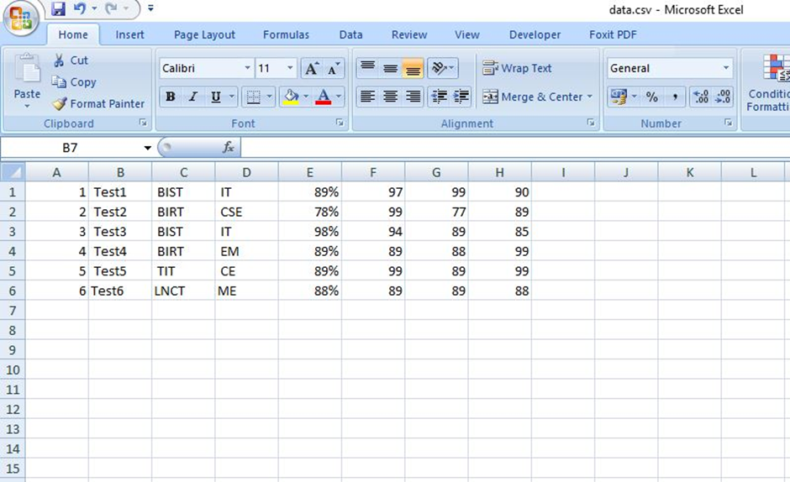
RECORDS SAVED IN EXCEL FILE

Slide 10
IMPORTANT NOTE
Password asked when executing program = “password”

